Slide 1

Analysis of medical data using machine learning methods (MLHC)
Michal Alayev and Lian Galanti

Slide 2
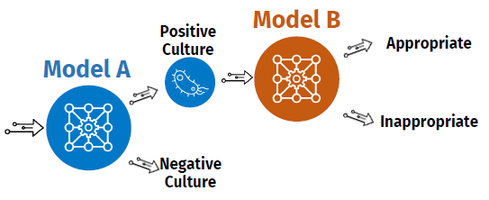

Project Introduction
Model A : Classification model of positive vs. negative blood cultures of patients with ICU-acquired infections, based on clinical data that was collected before culture collection time.
Model B : Classification model of appropriate vs. inappropriate treatment that was given to patients with positive blood cultures, based on the clinical data that was collected until 24 hours after culture collection time.

Slide 3
Cohorts
Model A:
 | MIMIC | eICU
Number of patients | 3075 | 126
Positives (% of patients) | 161 (5.24) | 8 (6.35)
Negatives (% of patients) | 2914 (94.76) | 118 (93.65)
Model B:
 | MIMIC
Number of patients | 105
Inappropriate (% of patients) | 22 (20.95)
Appropriate (% of patients) | 83 (79.05)

Slide 4
Features
The data we used for feature generation for both models included:
Demographics: gender, age, duration (in days) of hospitalization and ICU stay prior to the BC sampling time, etc.
Hight, weight and BMI on admission, and daily weight measurements.
Vital signs: heart rate, arterial blood pressure, SpO2, temperature, non-invasive blood pressure, etc.
Respiratory parameters: FiO2, respiratory rate, PEEP, tidal volume, etc.
Daily fluid balance: daily liquid output and input.
Medications: antibiotic treatment and pressor-sedatives medications.
Interventions: central venous lines, arterial lines, and dialysis catheters.
GCS score
Microbiology: blood, urine, stool, sputum, and IV-catheter tip cultures, that were taken up to 3 or 2 days (in model A or B respectively) prior to the cohort's BC sampling time.
Laboratory measurements: complete blood count, leukocytes differential, basic metabolic panel, blood gases, coagulation panel and Liver function

Slide 5
Model A
Preprocessing: We removed features with more then 70% missing values rate.
Next, we split the MIMIC dataset into 5 fixed groups for 5-fold cross-validation. For each fold we performed:
Imputation: the train and test data were imputed separately with KNN, using 10 nearest neighbors and uniform weight function.
Class balancing: the train data was balanced using Borderline SMOTE for oversampling (adding positive samples).
Standardization: the train and test data were separately standardized by removing the mean of each feature and scaling to unit variance, using Standard Scaler.
Feature selection: we applied feature selection to the train data, keeping the 40 features with highest scores according to ANOVA F-value (KBest method).
Training the model: for classification we used logistic regression with the lbfgs solver, and norm 2 for penalization.
Testing: running the trained model on the imputed and standardized test data.

Slide 6
Model B
Preprocessing: We removed features with more then 70% missing values rate. Then we removed features with variance lower than 0.15.
We split the dataset with the remaining features into 5 fixed groups for 5-fold cross-validation. For each fold we performed:
Imputation: the train and test data were imputed separately with KNN, using 5 nearest neighbors and uniform weight function.
Class balancing: the train data was balanced using Tomek Links for undersampling (removing appropriate treatment samples).
Standardization: the train and test data were separately standardized by removing the mean of each feature and scaling to unit variance, using Standard Scaler.
Feature selection: we applied a logistic regression feature selection algorithm on the train data, with the lbfgs solver and norm 2 for penalization, keeping the 10 features with the greatest coefficient (negative or positive).
Training the model: for classification we used logistic regression with the lbfgs solver, and norm 2 for penalization.
Testing: running the trained model on the imputed and standardized test data.

Slide 7
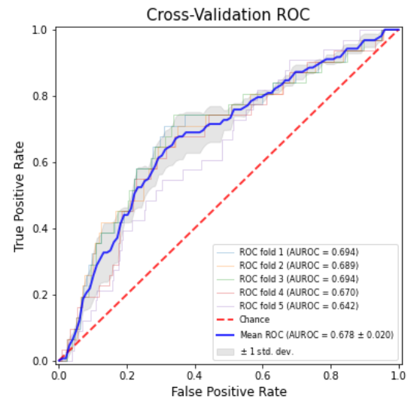
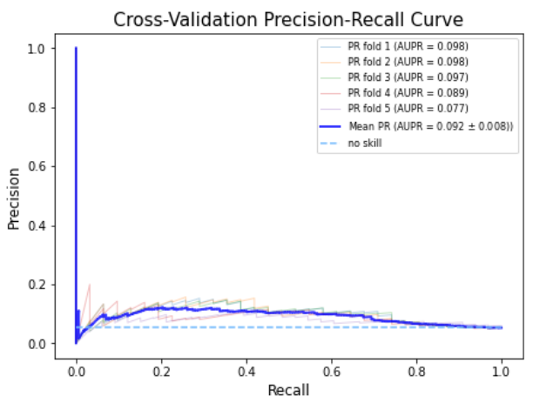
5-Fold Cross Validation Results - Model A
AUROC mean: 0.678 AUPR mean: 0.092 AUROC std: 0.020 AUPR std: 0.008

Slide 8
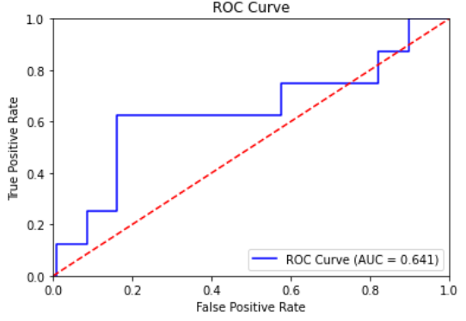
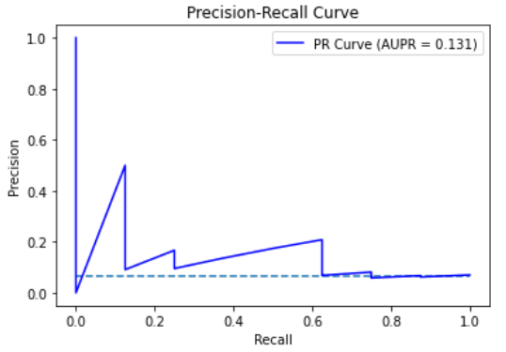
Model A - eICU as a validation set
We made a second evaluation for model A, with the whole MIMIC dataset as train data, and the eICU dataset as the test data. This required both datasets to have the same features, as we designed in the feature generation step.
Results
AUROC: 0.641 AUPR: 0.131

Slide 9
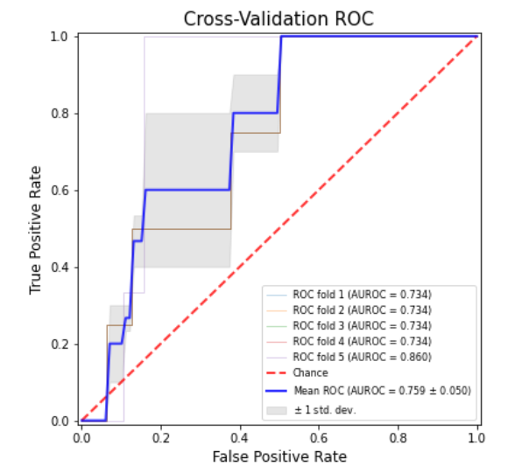
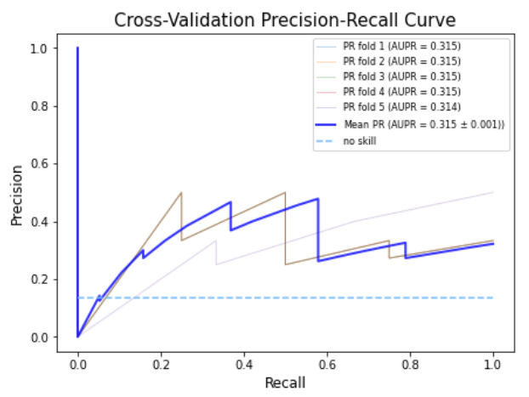
5-Fold Cross Validation Results - Model B
AUROC mean: 0.759 AUPR mean: 0.315 AUROC std: 0.050 AUPR std: 0.001

Slide 10


